Slide 1
OpenChain Japan Work Group
Meeting #28 / Hybrid #3

Slide 2
Anti-Trust Policy Notice
Linux Foundation meetings involve participation by industry competitors, and it is the intention of the Linux Foundation to conduct all of its activities in accordance with applicable antitrust and competition laws. It is therefore extremely important that attendees adhere to meeting agendas, and be aware of, and not participate in, any activities that are prohibited under applicable US state, federal or foreign antitrust and competition laws.
Examples of types of actions that are prohibited at Linux Foundation meetings and in connection with Linux Foundation activities are described in the Linux Foundation Antitrust Policy available at http://www.linuxfoundation.org/antitrust-policy. If you have questions about these matters, please contact your company counsel, or if you are a member of the Linux Foundation, feel free to contact Andrew Updegrove of the firm of Gesmer Updegrove LLP, which provides legal counsel to the Linux Foundation.

Slide 3
News

Slide 4
ISO/IEC DIS 18974 Passed The ISO Ballot
We expect it to become a formal ISO/IEC standard within 30 days
We expect it to have this ISO/IEC number: ISO/IEC 18974:2023
Conformance is ready: https://www.openchainproject.org/checklist-iso-dis-18974
Companies are already adopting (LG Electronics, BlackBerry, Interneuron)
Conformance to de-facto standards (OpenChain Security Assurance 1.0, 1.1 and ISO/IEC DIS 18974 are also valid for ISO/IEC 18974.

Slide 5
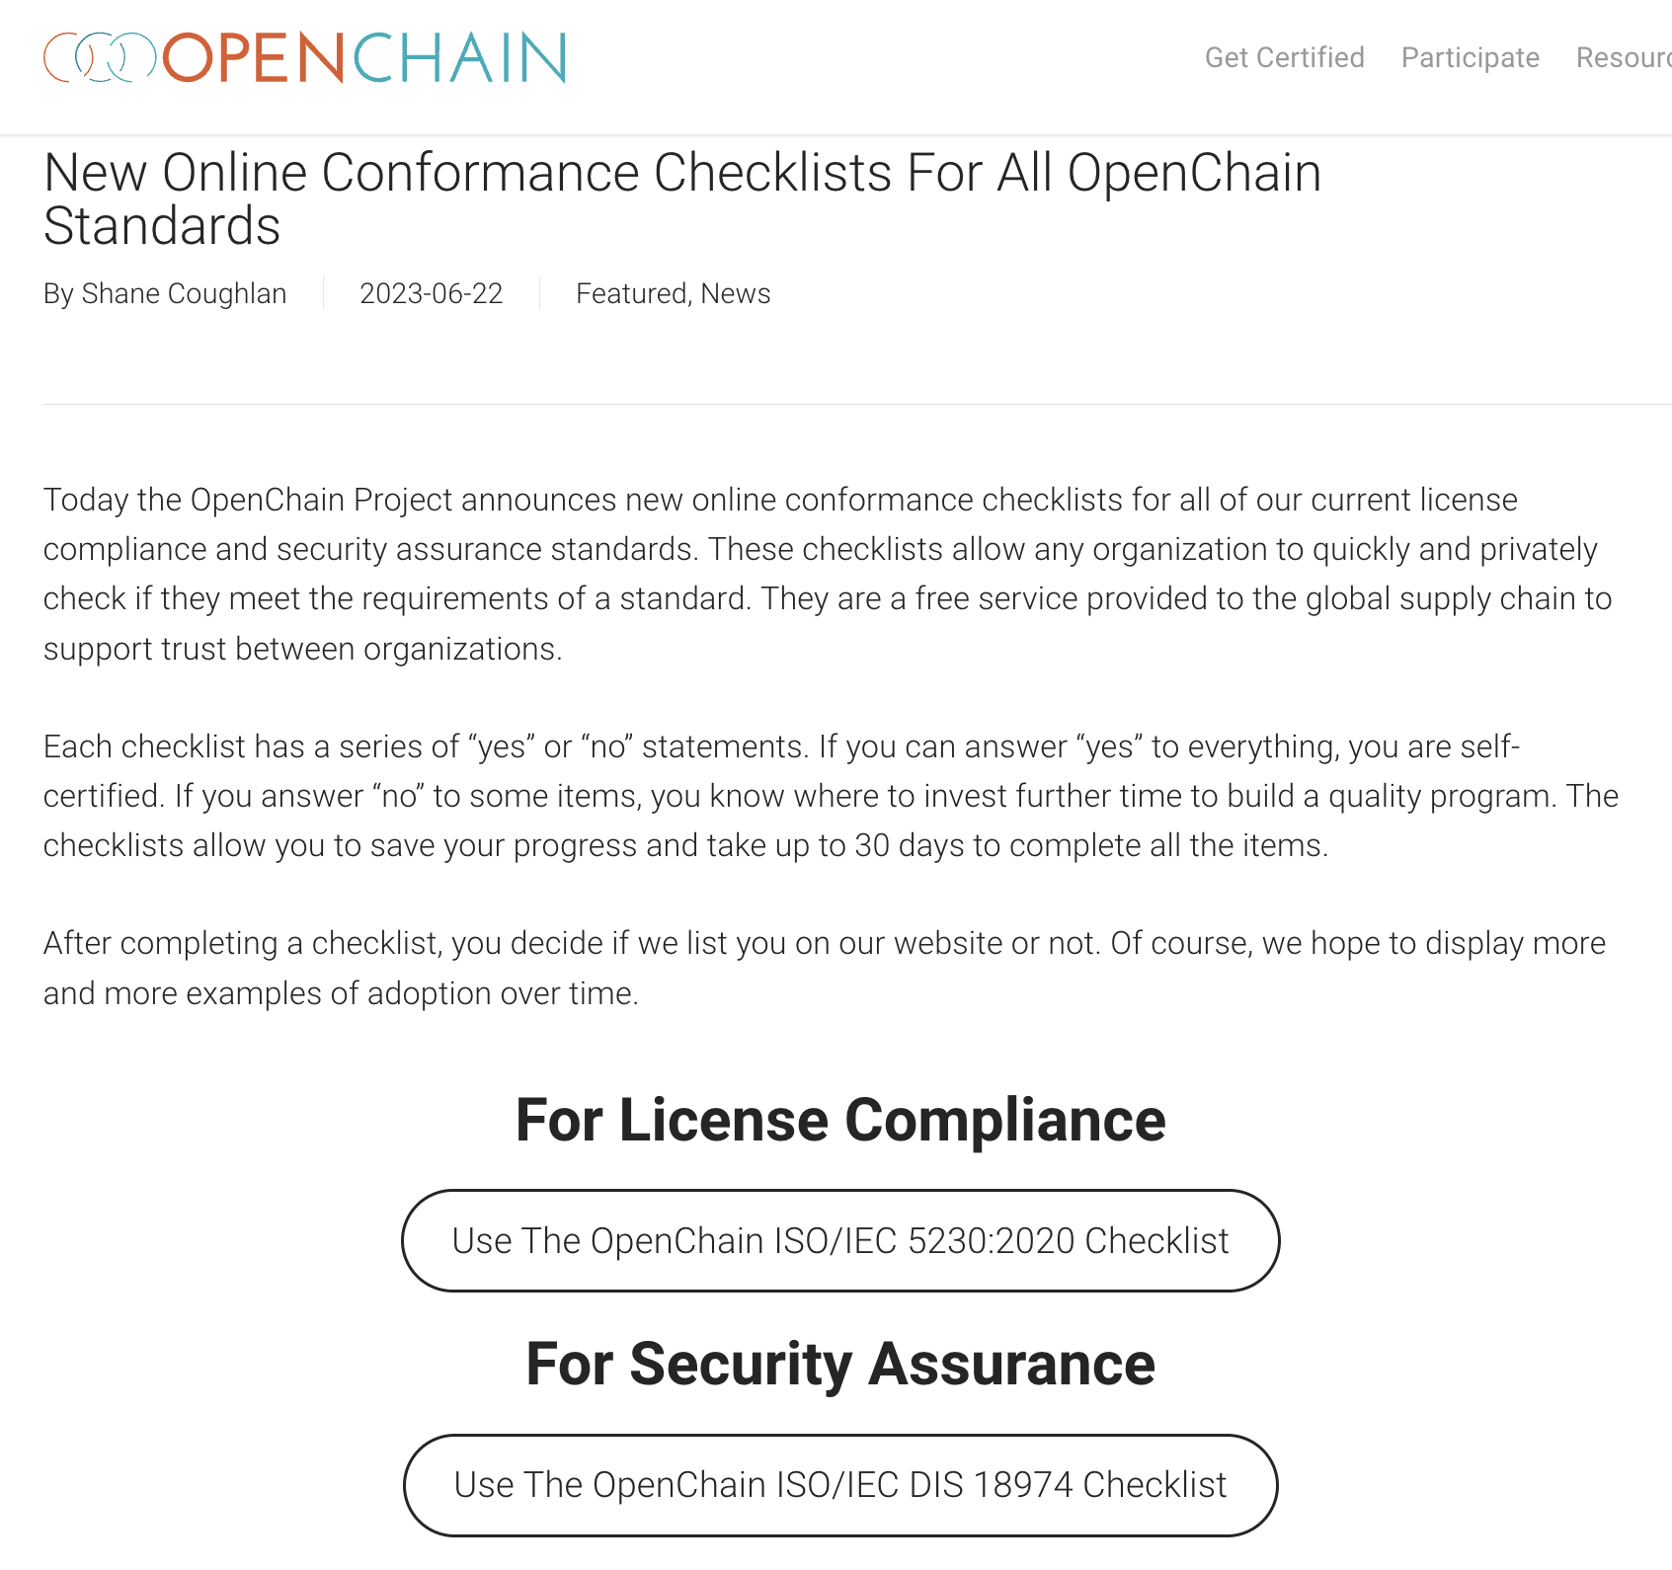
New Conformance Checklists For All Standards
https://www.openchainproject.org/get-started

Slide 6

xFusion is the 100th organization to announce an OpenChain Conformant Program through our website
https://www.openchainproject.org/news/2023/06/27/xfusion

Slide 7

LINE Announces An OpenChain ISO/IEC 5230 Program for Open Source Compliance
https://www.openchainproject.org/featured/2023/07/05/line-iso-iec-5230

Slide 8
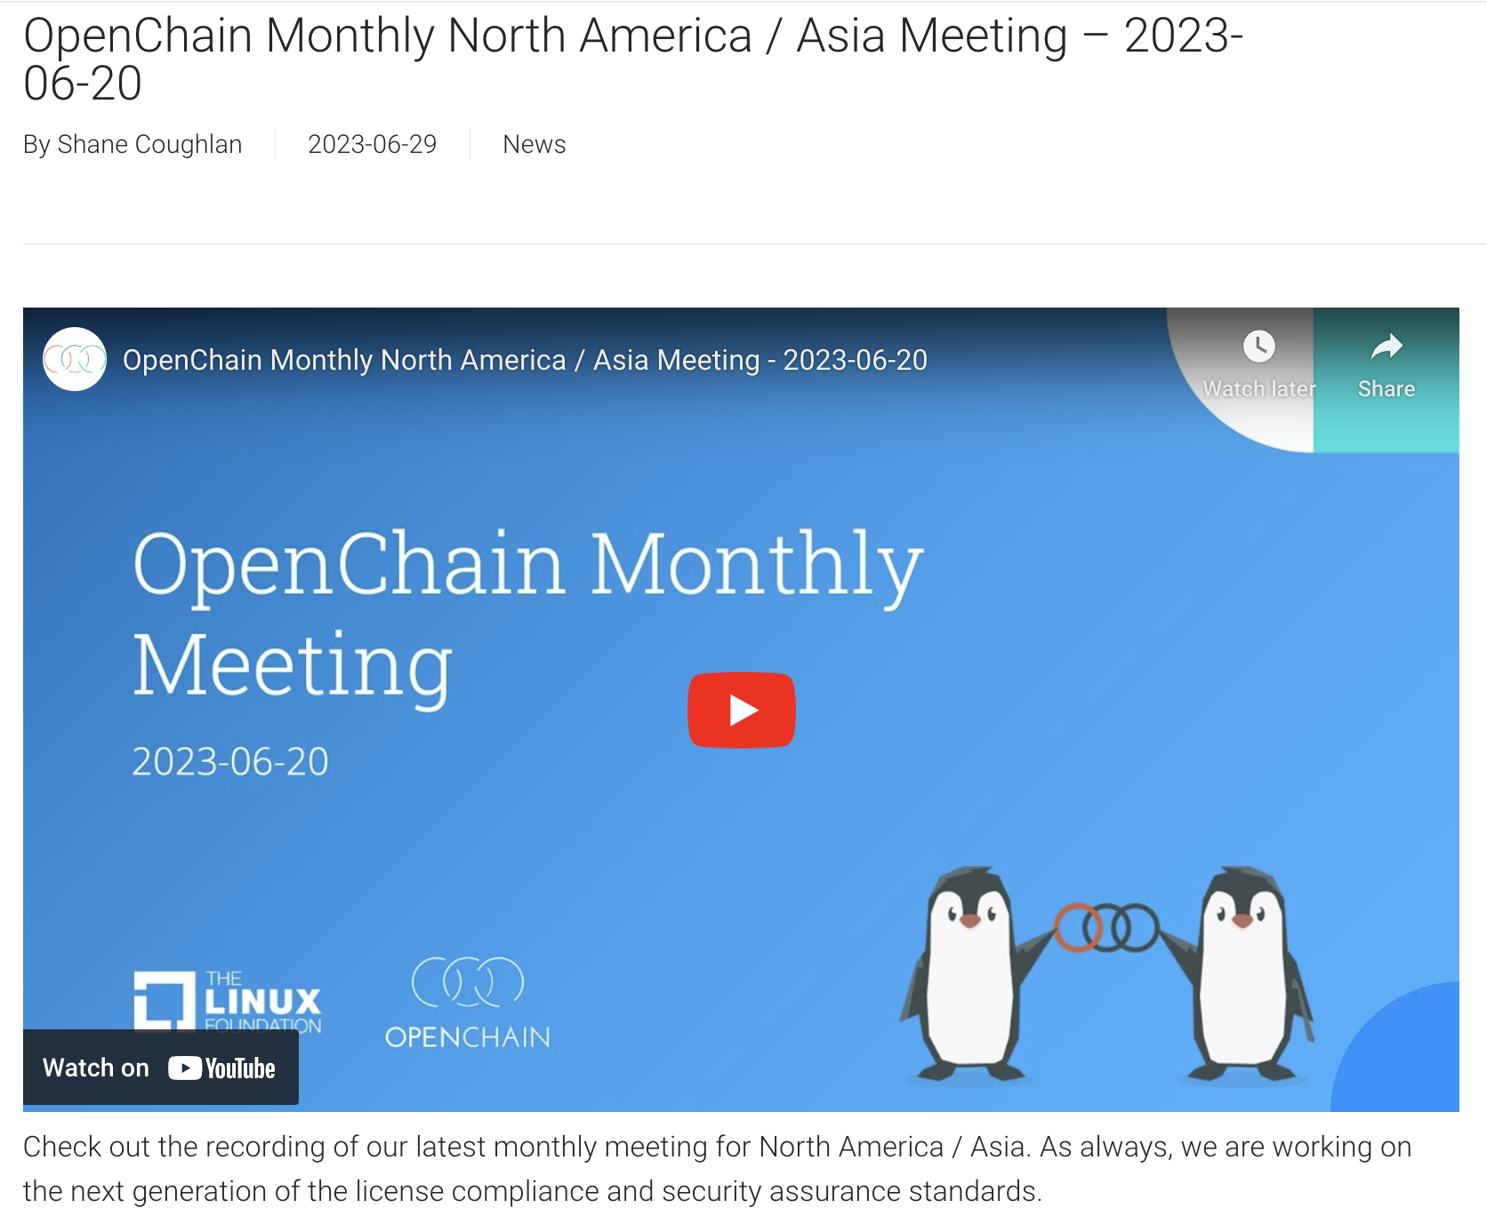
Next Generation Specification Editing Continues
https://www.openchainproject.org/news/2023/06/29/monthly-na-asia-2023-06-20

Slide 9
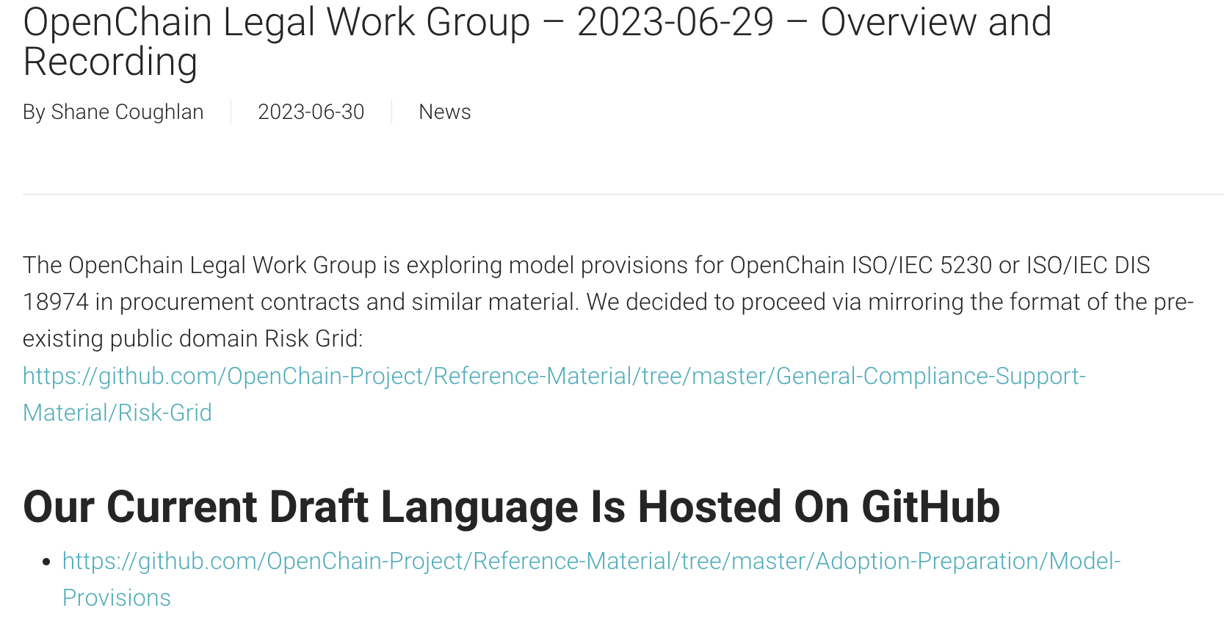
Legal Work Group Has Draft Model Provisions
https://www.openchainproject.org/news/2023/06/30/openchain-legal-work-group-2023-06-29-overview-and-recording

Slide 10
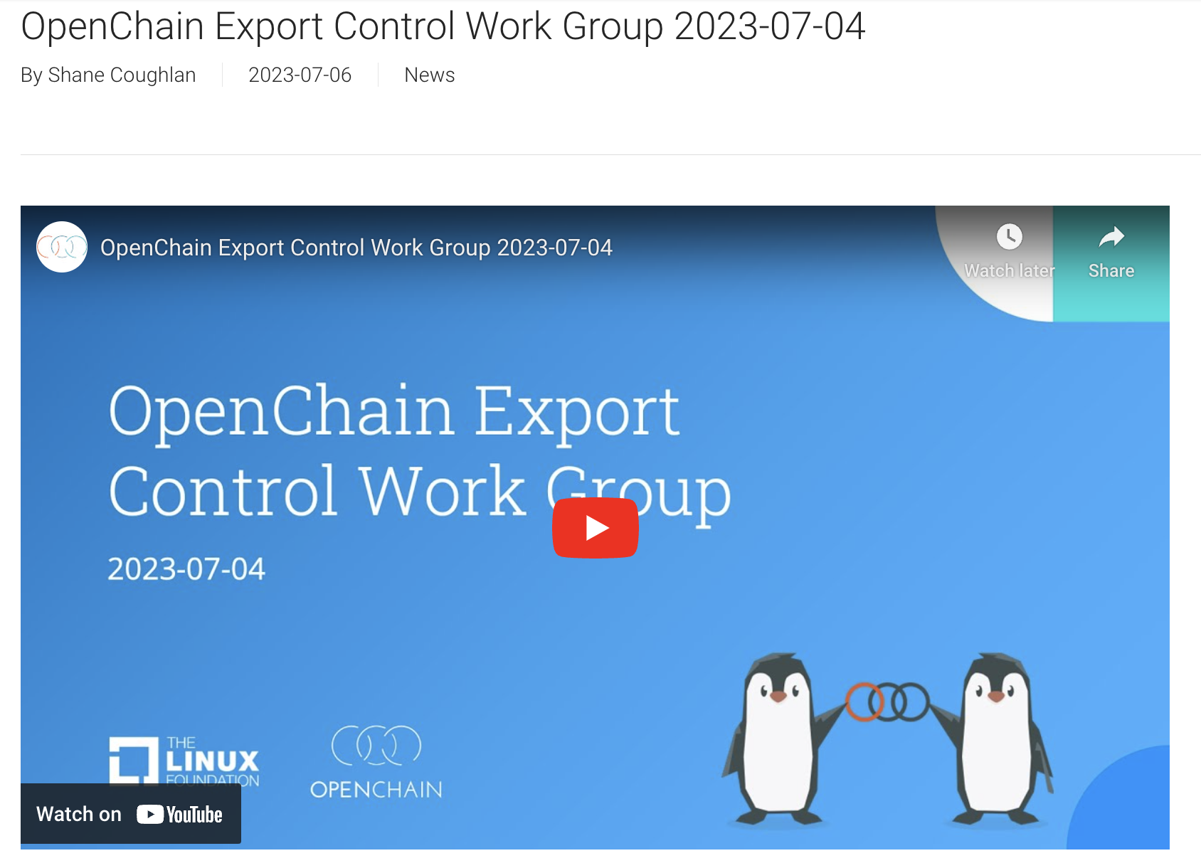
Export Control Work Group Requests Help
https://www.openchainproject.org/news/2023/07/06/openchain-export-control-work-group-2023-07-04

Slide 11

OpenChain Mini-Summit @ OSS NA – Recordings
https://www.openchainproject.org/news/2023/06/30/openchain-mini-summit-oss-na-recording

Slide 12

Automotive Work Group – Major Meeting
https://www.openchainproject.org/news/2023/06/29/automotive-wg-2023-06-14

Slide 13
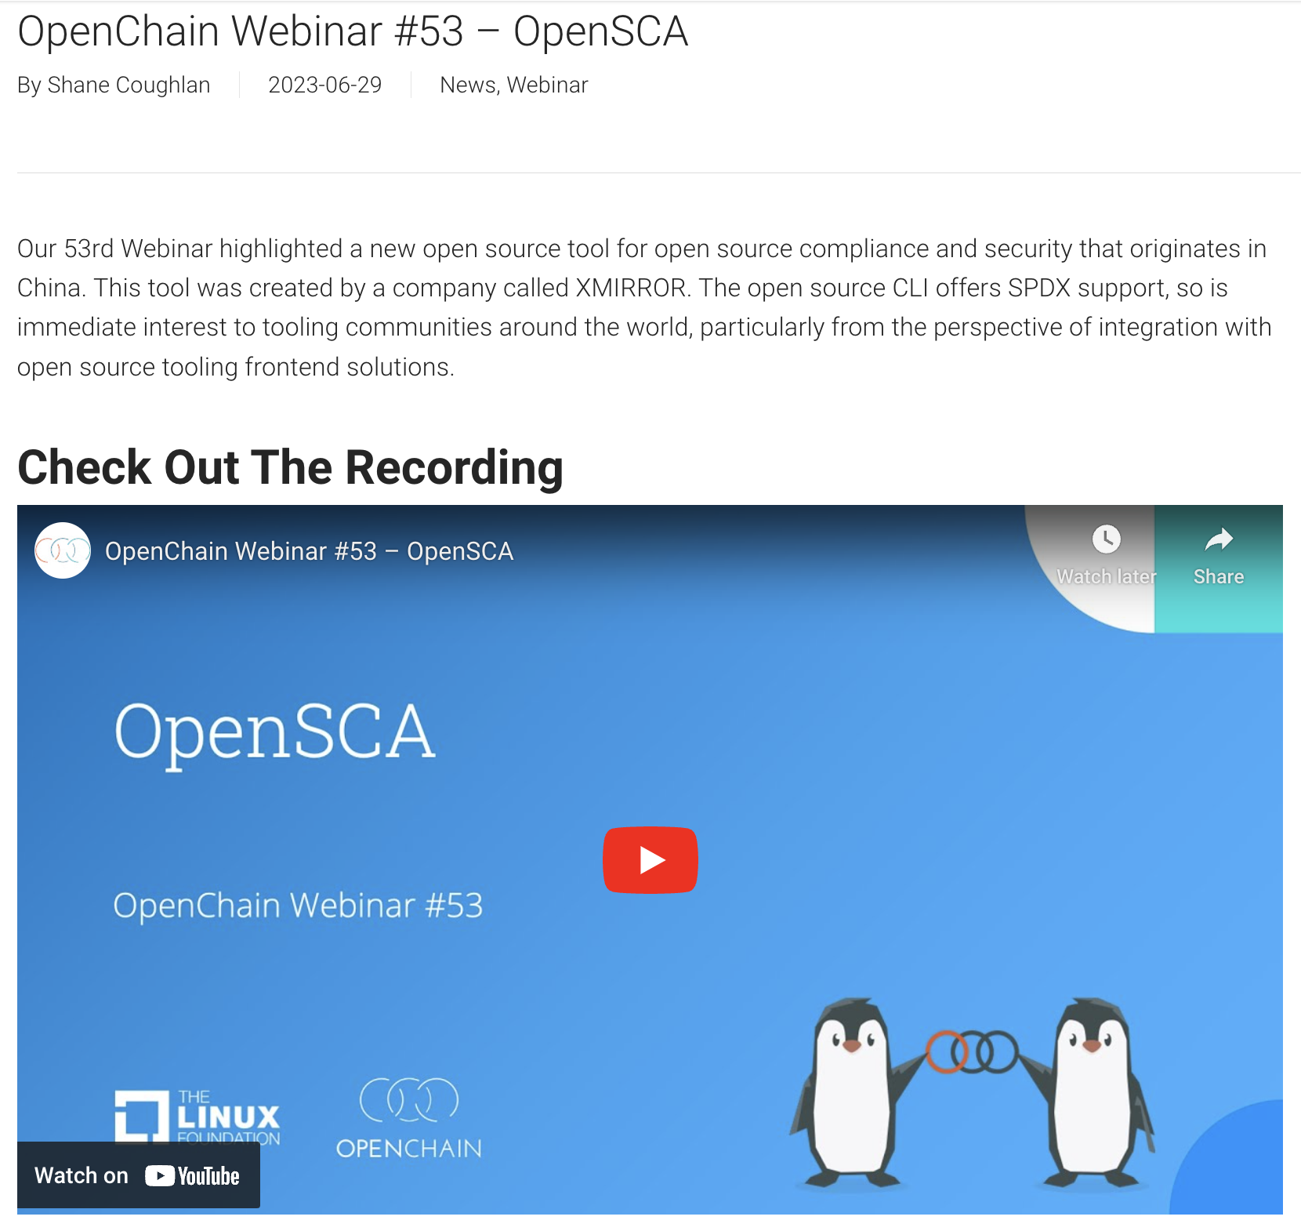
New Chinese Open Source CLI For Compliance
https://www.openchainproject.org/news/2023/06/29/webinar-53

Slide 14
Data

Slide 15
OpenChain Industry Survey 2023
We had a terrible response rate (18 companies)
Partly this was politics:
Example: Taiwanese companies refused to fill out the form because it said ”Taiwan (China)” but it seems Chinese companies did not see filling out the form as a priority either
Partly this was sheer lack of momentum in the narrow timescale we used (2 months)
To fix this we are:
Working with LF Research and major international companies for future work
Going to give surveys more time to be completed

Slide 16
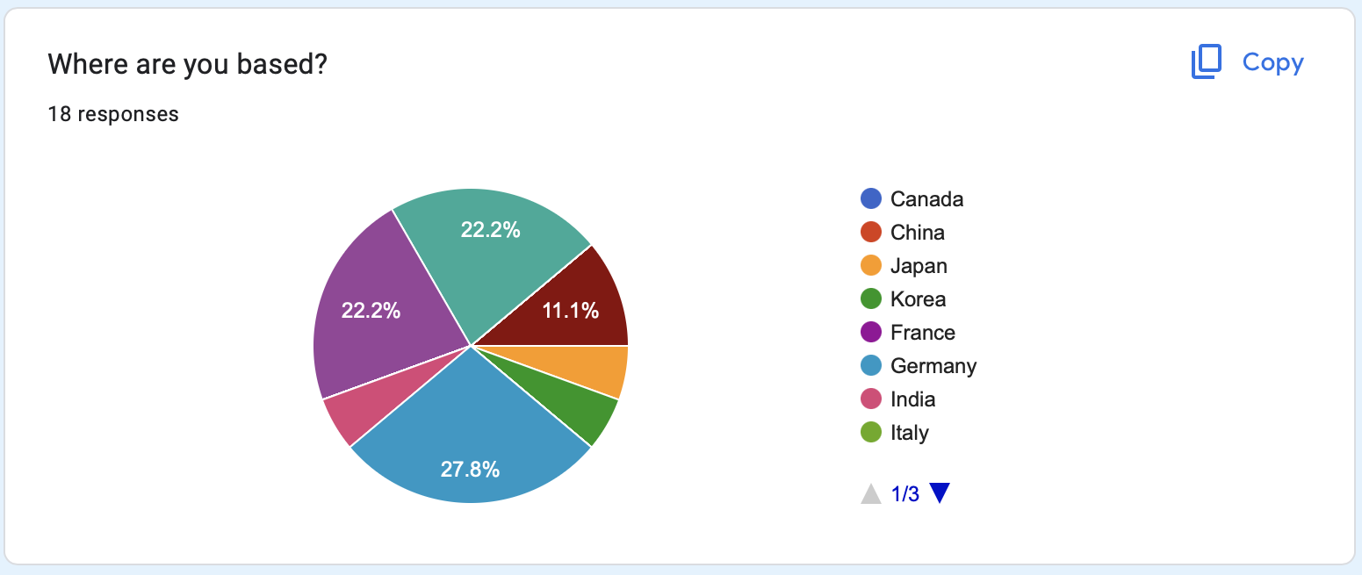
OpenChain Industry Survey 2023 - Insights
33.3% of companies that filled out the form were new to us – interesting!

Slide 17
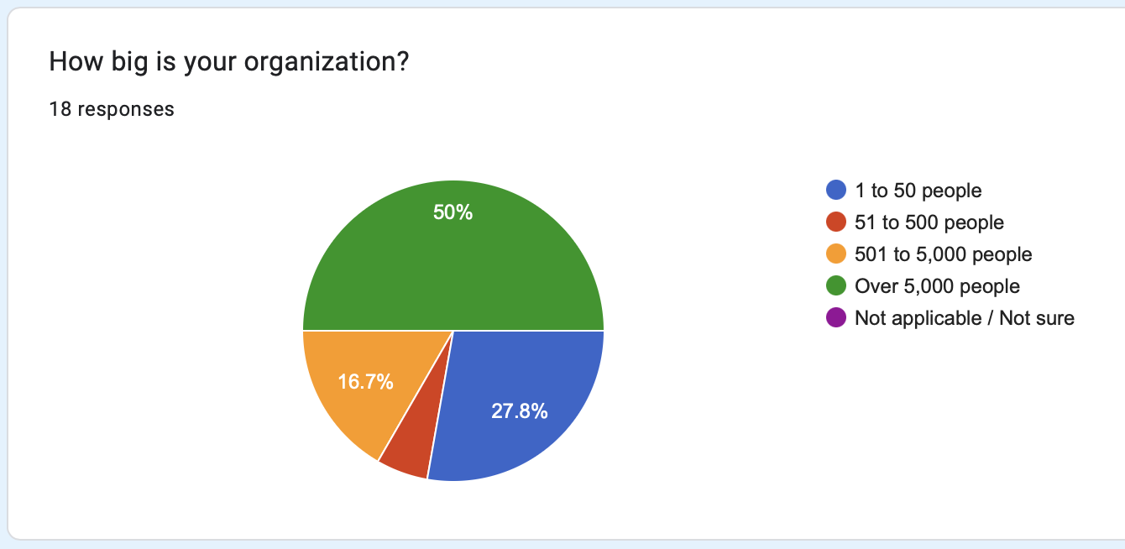
OpenChain Industry Survey 2023 - Insights
European and North American companies engaged more with the survey
Around half of the companies are < 5,000 people

Slide 18
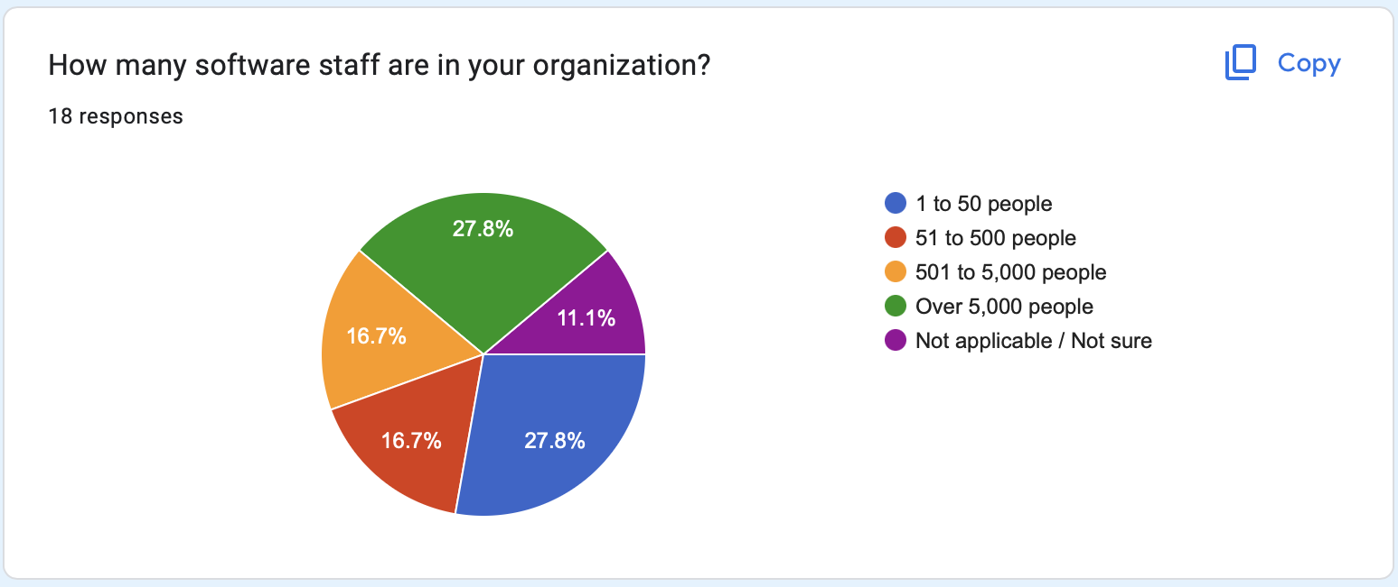
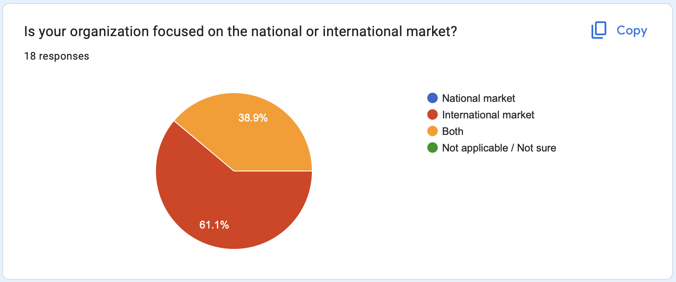
OpenChain Industry Survey 2023 - Insights
More than half the companies have > 5,000 software staff
All are doing business in international markets

Slide 19
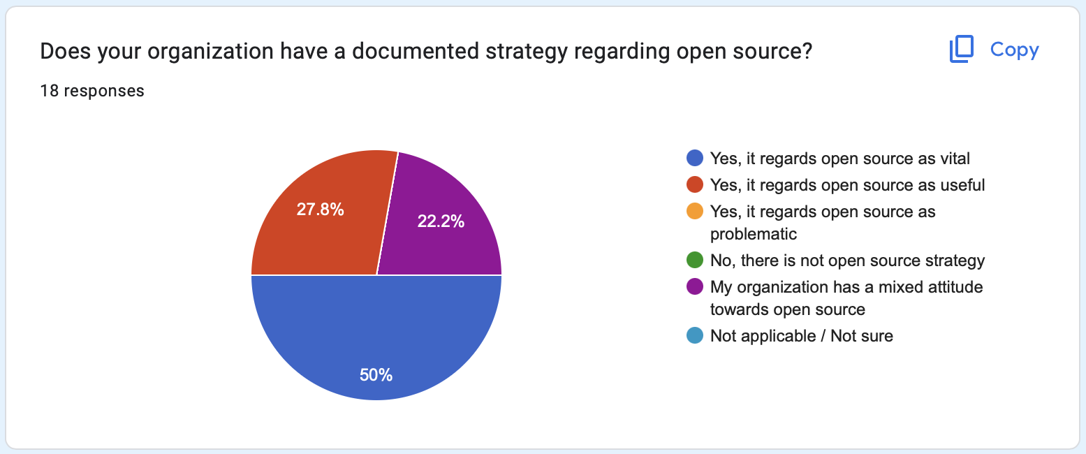
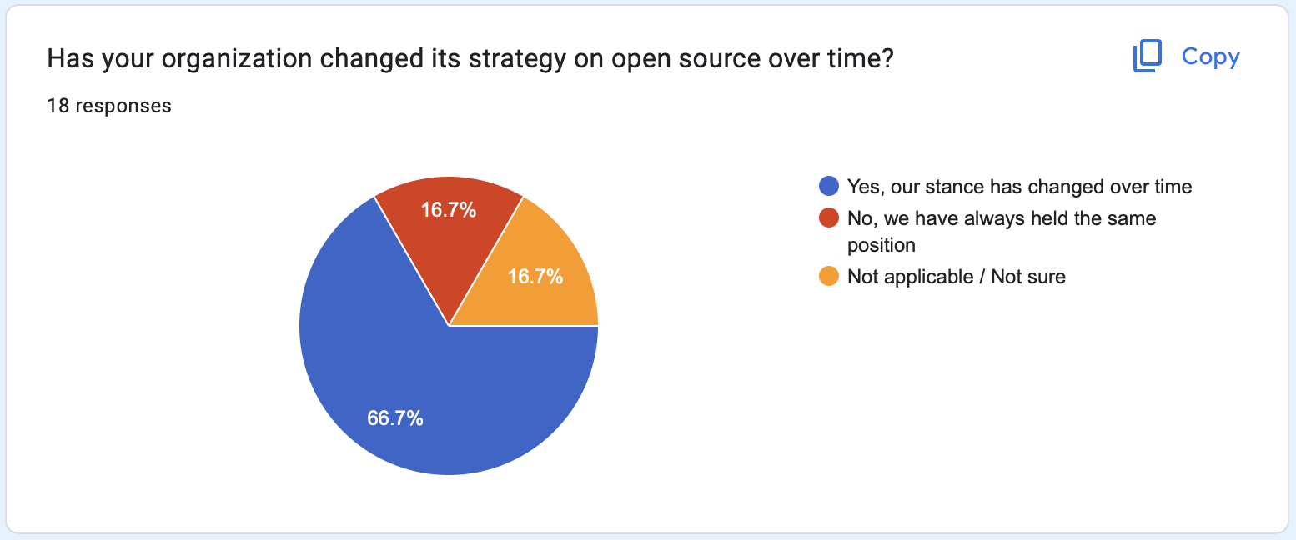
OpenChain Industry Survey 2023 - Insights
Only half the companies see open source as vital
But 2/3 have changed their stance over time

Slide 20
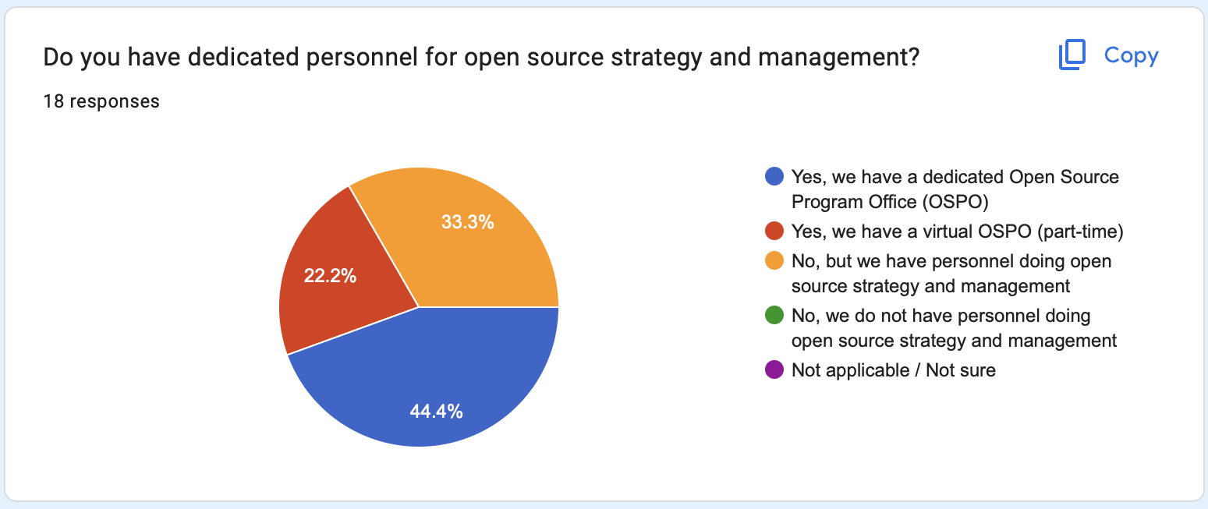
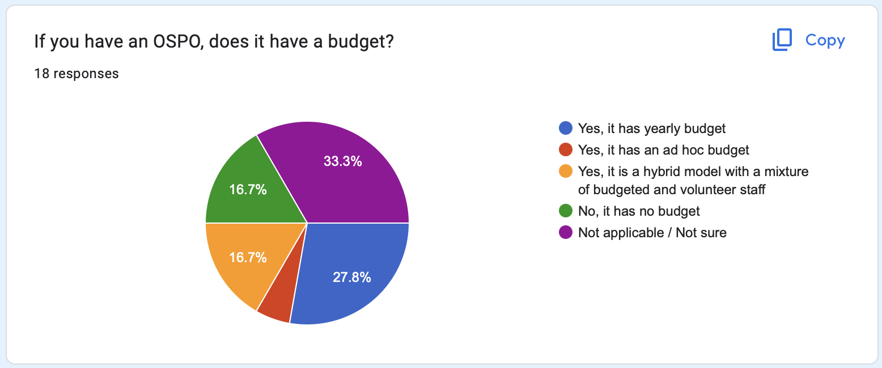
OpenChain Industry Survey 2023 - Insights
Every company has open source strategy people
However, only half of OSPOs have a known budget

Slide 21
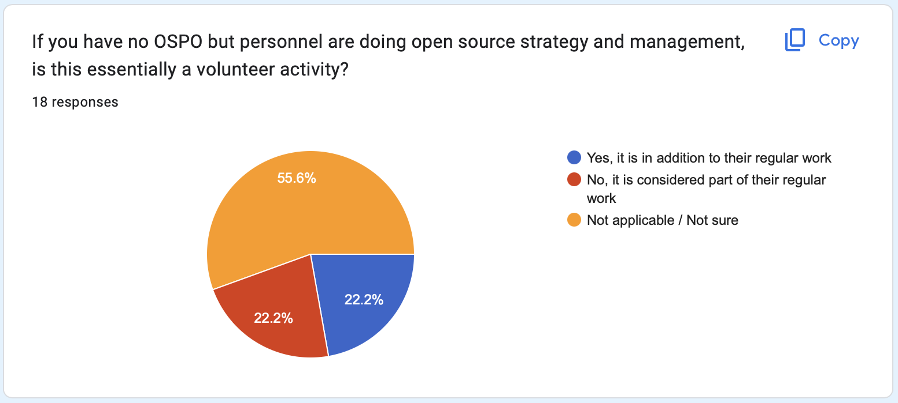
OpenChain Industry Survey 2023 - Insights
For 22.2% of companies, open source management is a volunteer activity

Slide 22
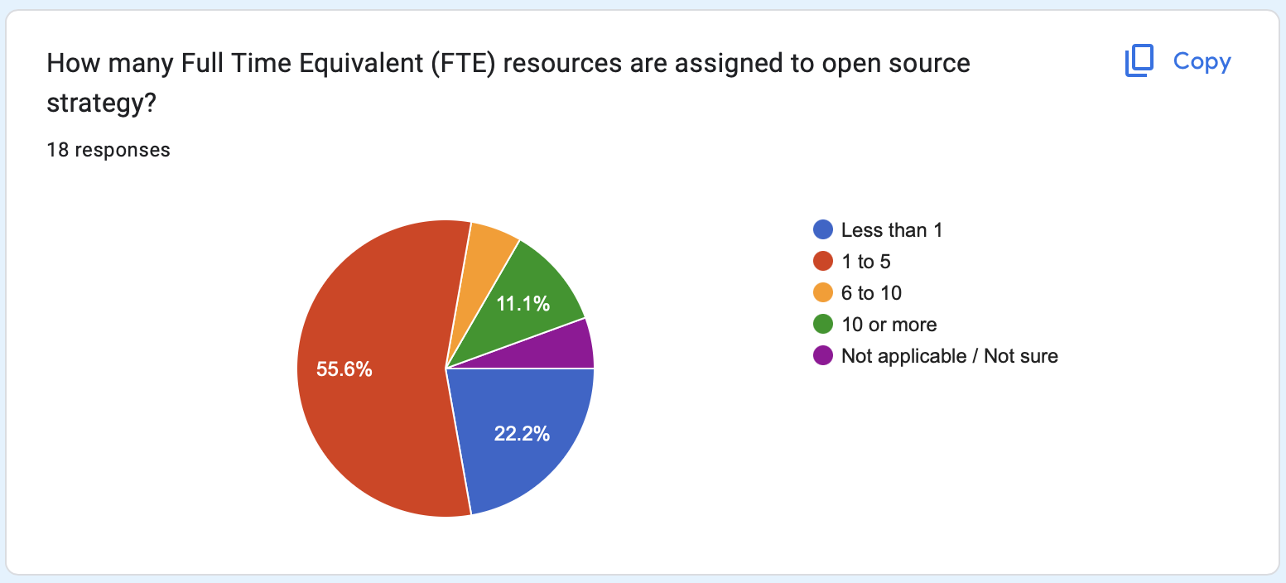
OpenChain Industry Survey 2023 - Insights
More than 50% of companies have less than 5 people managing open source

Slide 23
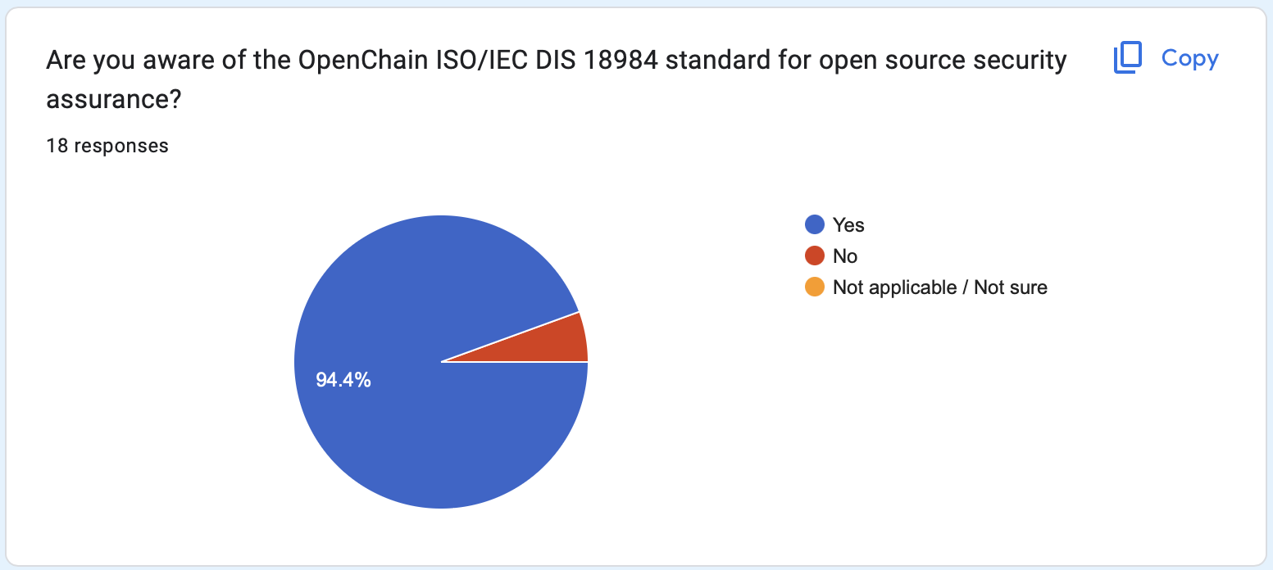
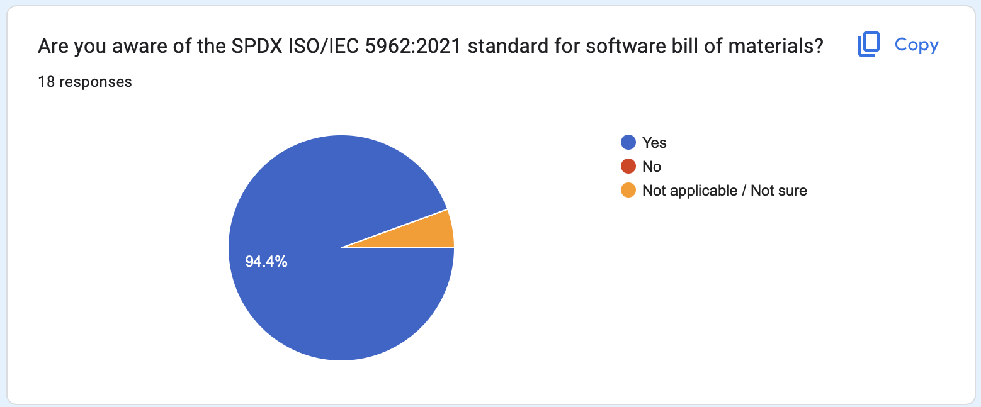
OpenChain Industry Survey 2023 - Insights
Interestingly, the same number of companies know about our security standard as knew about SPDX

Slide 24
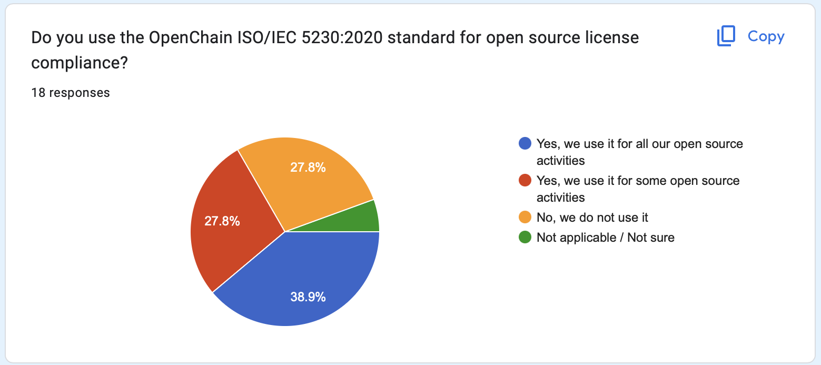
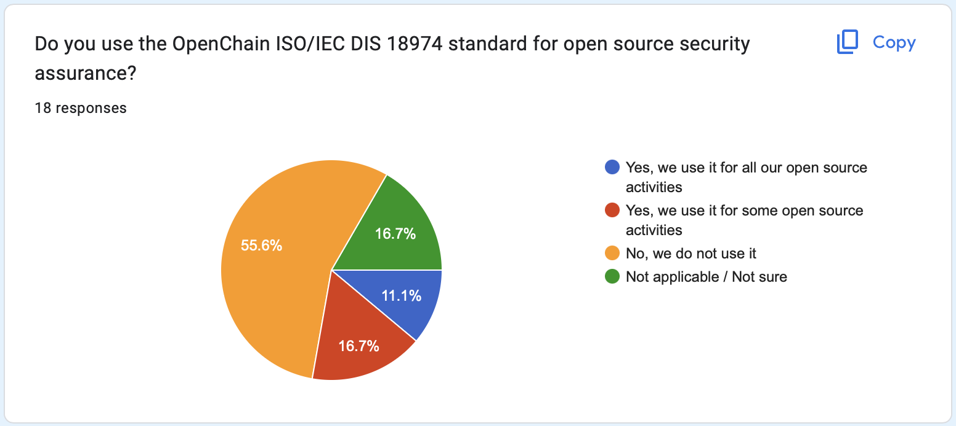
OpenChain Industry Survey 2023 - Insights
66.7% of companies are using our standard for compliance, and 27.8% are already using our standard for security
(61.1% use SPDX)

Slide 25
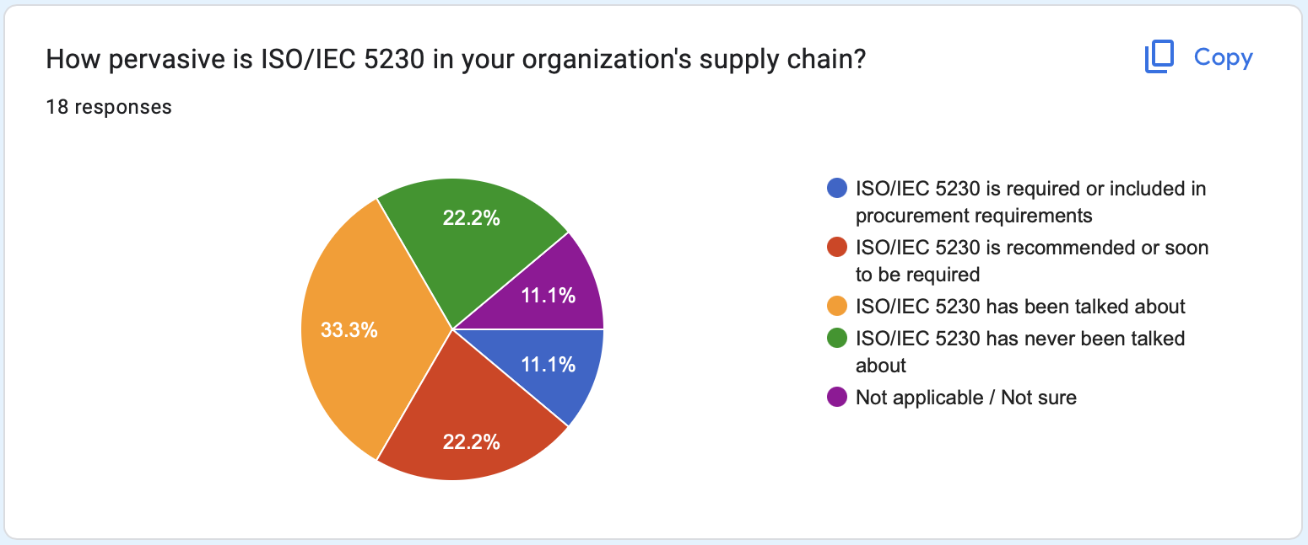
OpenChain Industry Survey 2023 - Insights
33.3% of companies are using our licensing standard in their supply chain 33.3% of companies are in discussions about it

Slide 26
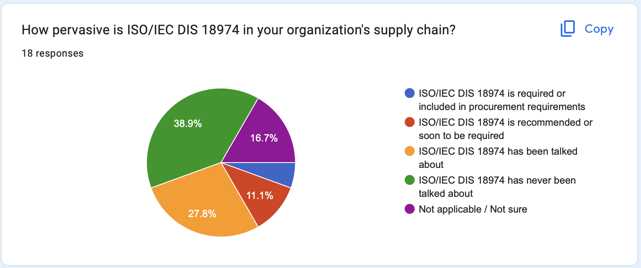
OpenChain Industry Survey 2023 - Insights
5.5% of companies are using our security standard in their supply chain

Slide 27
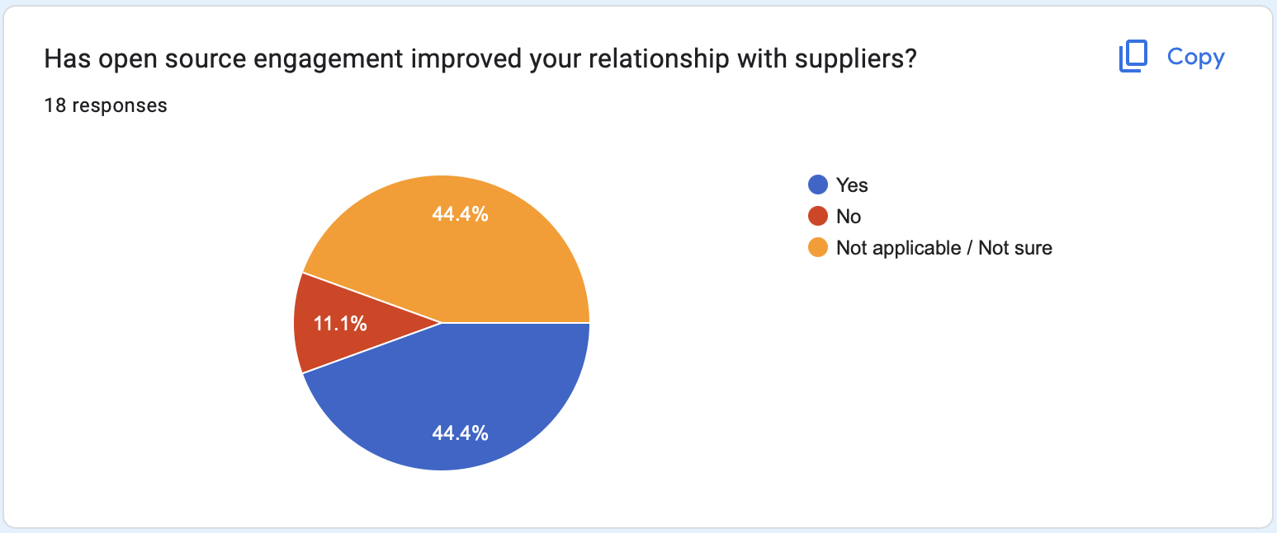
OpenChain Industry Survey 2023 - Insights
44.4% of companies think open source has improved supplier relationships
But 11.1% think it has not improved their supply relationships

Slide 28
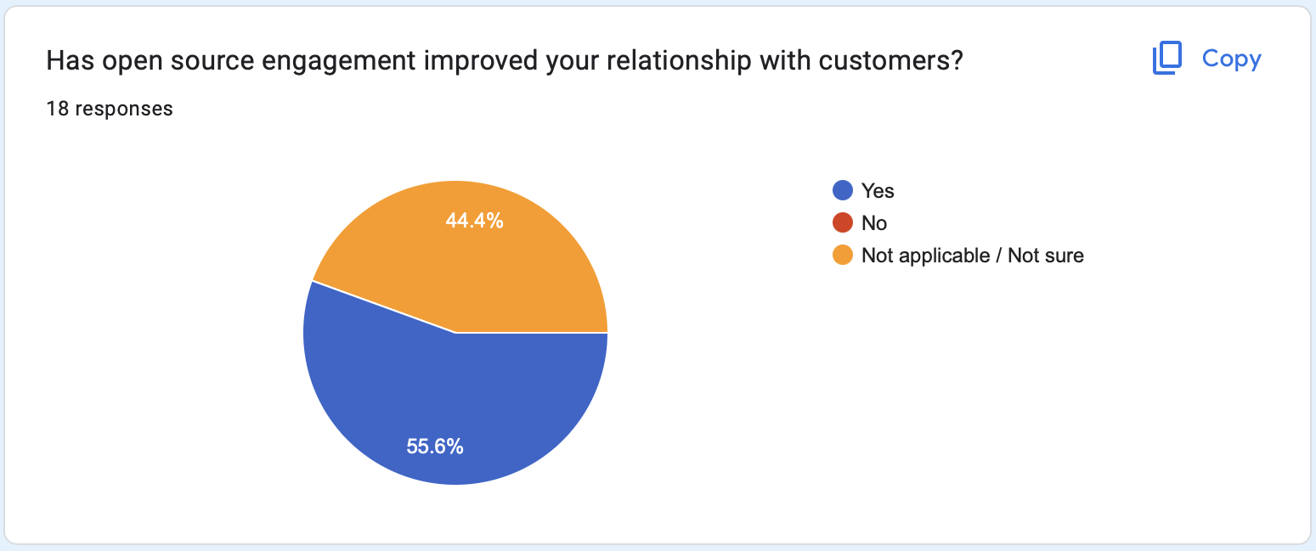
OpenChain Industry Survey 2023 - Insights
55.6% of companies think open source has improved customer relationships

Slide 29
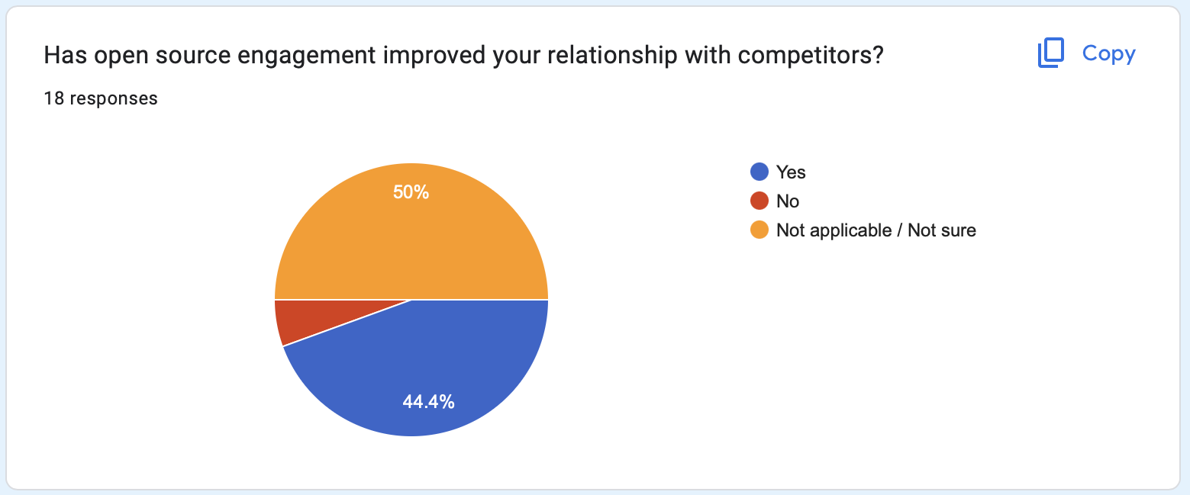
OpenChain Industry Survey 2023 - Insights
44.4% of companies think open source has improved competitor relationships But 5.6% think it has not improved competitor relationships

Slide 30

Deloitte Is Now An Official Partner
https://www.openchainproject.org/news/2023/06/22/deloitte-official-partner

Slide 31
Deloitte will help with the next survey

Slide 32
tl;dr
We are making a difference
But there is more to do

